Slide 1


Machine Learning Capstone Project Unsupervised Learning: Clustering
Topic- Netflix Movies and TV Shows Clustering
Submitted by- Subhasis Chattopadhyay
E-mail id : subhasischattopadhyaydbb@gmail.com

Slide 2

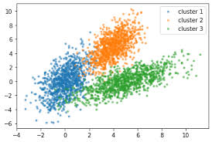
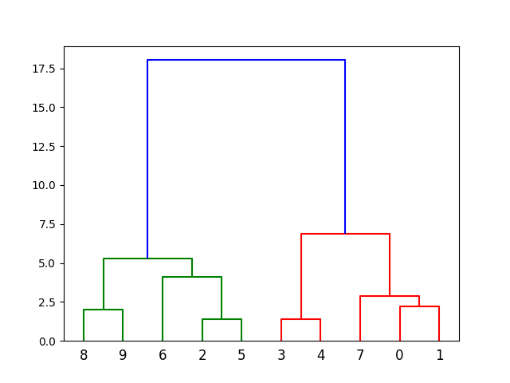
What is Clustering?
Clustering or cluster analysis is a machine learning technique, which groups the unlabeled dataset. It can be defined as "A way of grouping the data points into different clusters, consisting of similar data points. The objects with the possible similarities remain in a group that has less or no similarities with another group."
It does it by finding some similar patterns in the unlabelled dataset such as shape, size, colour, behavior, etc., and divides them as per the presence and absence of those similar patterns.
It is an unsupervised learning method, hence no supervision is provided to the algorithm, and it deals with the unlabeled dataset.
After applying this clustering technique, each cluster or group is provided with a cluster-ID. ML system can use this id to simplify the processing of large and complex datasets.

Slide 3


Topics to discuss:
Problem Statement
Data description
Data summary
Exploratory Data Analysis
Data pre-processing
Clustering
Parameters Evaluation
Recommendation System
Conclusion

Slide 4

Problem Statement
This Dataset consists of TV shows and movies available on Netflix as of 2019. The dataset is collected from Flixable which is a third party Netflix search engine. In 2018, they released an interesting report which shows that the number of TV shows has recently tripled, while the number of movies has decreased by more than 2000 titles since 2010. It will be interesting to explore what all other insights can be obtained from the same Dataset. Integrating this Dataset with other external datasets such as IMDB ratings, rotten tomatoes can also provide many interesting findings. In this project, you are required to do
EDA
Understanding what type content is available in different countries
If Netflix is increasingly focusing on TV rather that movies in recent years
Clustering similar content by matching text-based features

Slide 5
Data description
Show_id- Unique ID for each movie or TV show
type- Identifier-A movie or a TV show
title- Title of the movie or TV show
director- Director of the show
cast- Actors involved
Country- Country of production
date_added- Date it was added on Netflix
release_year- Actual release year of the show
rating- TV rating of the show
duration- Total duration in minutes or number of seasons
listed_in- Genre
description- The summary description

Slide 6

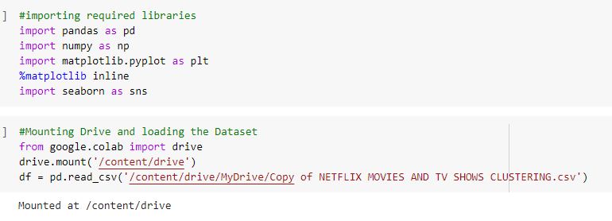
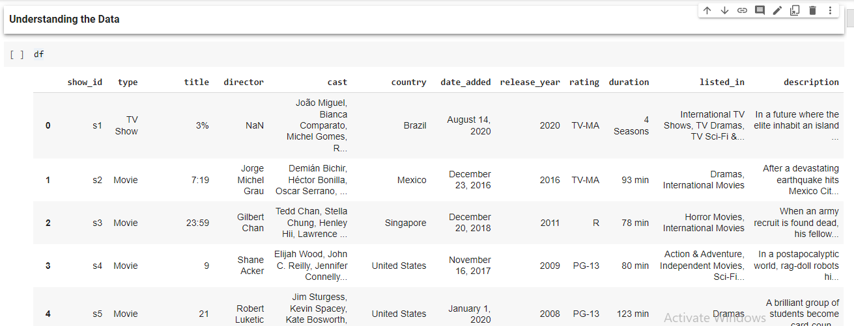
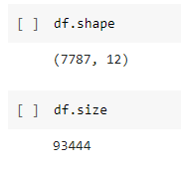
Data Summary
Loading the Dataset
Shape and Size of Dataset

Slide 7
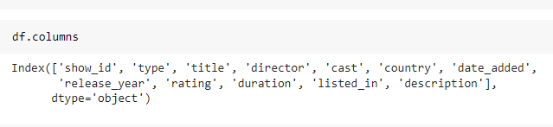
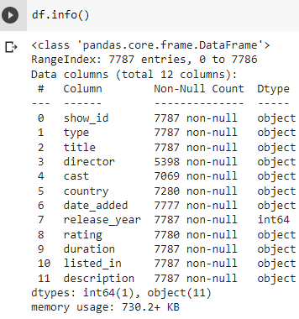
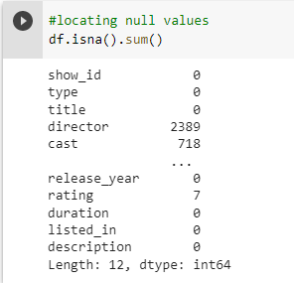
Data Summary(Cont…)
.columns is used to get names of each columns
.info() is used to obtain information about each columns
.isna().sum() is used to obtain the number to NaN values in each columns

Slide 8
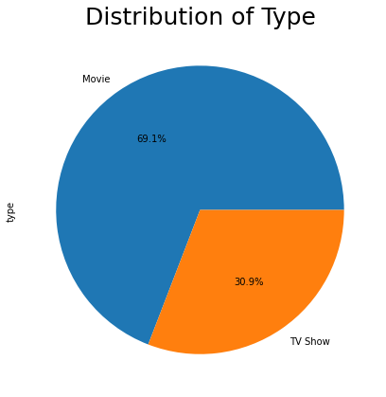
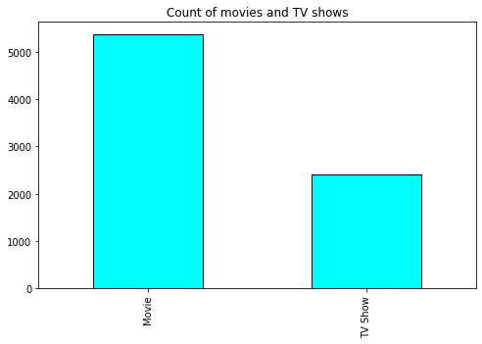

Exploratory Data Analysis(EDA)
Analysis on Type

Slide 9
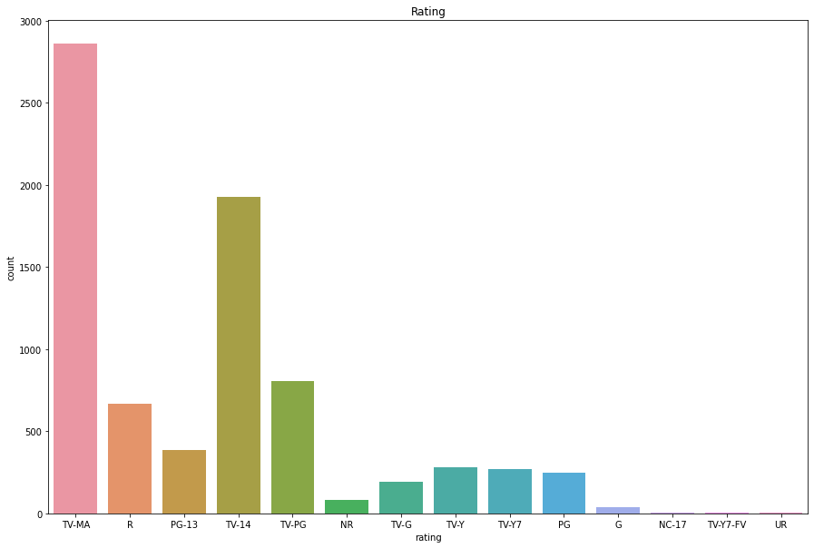
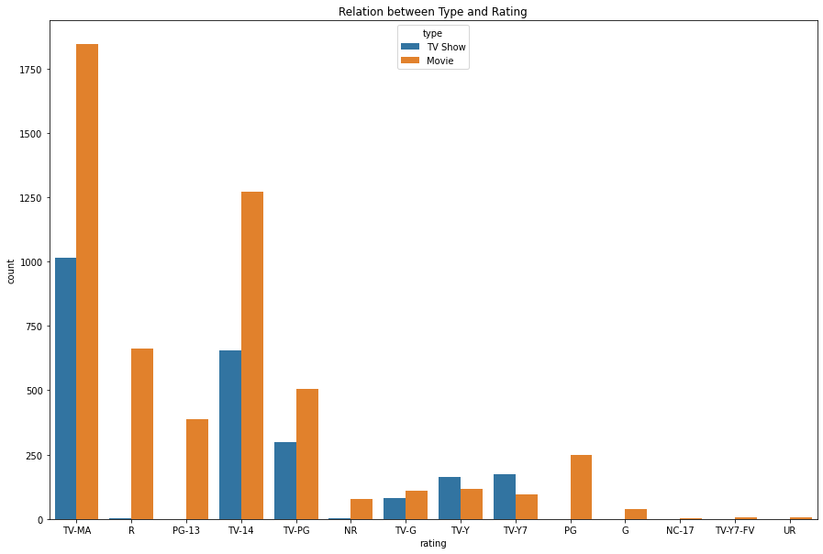
Analysis on Rating
Most of the Movies and TV shows have rating of TV-MA (Mature Audience), However, for the younger audience (under the age of 17), it is the opposite, there are slightly more TV shows than there are movies.

Slide 10
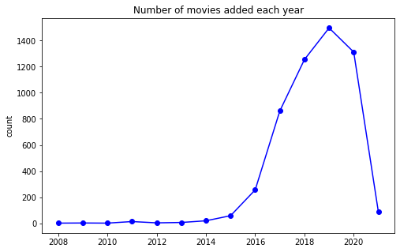
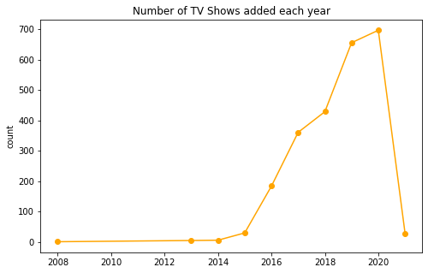
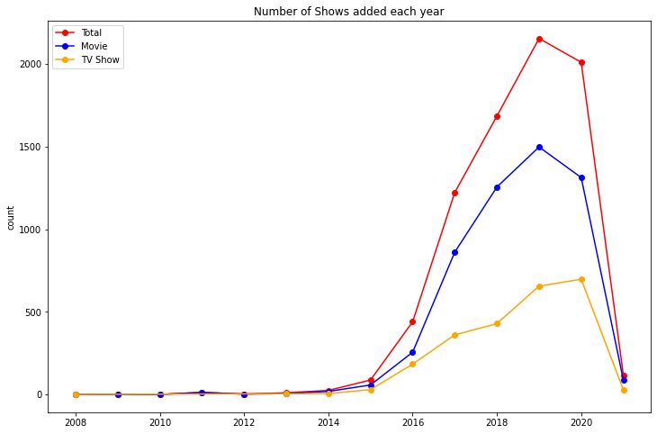
Analysis of Movies and TV Shows added over time
Based on these line graphs, we can see that Netflix started gaining popularity after 2014. Since then, the amount of content added has been increasing multi-fold.
But after 2019, the no. of contents added per year to streaming platform is going down. May be this due the world pandamic (covid-19).

Slide 11
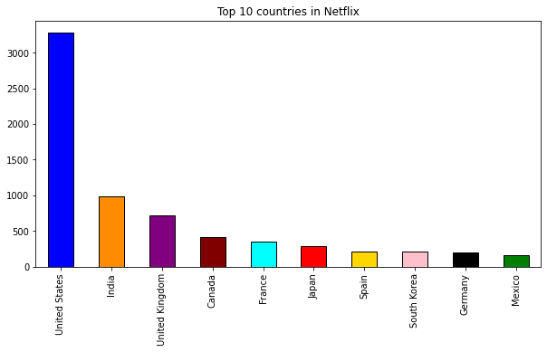
Countries with highest content creation

Slide 12
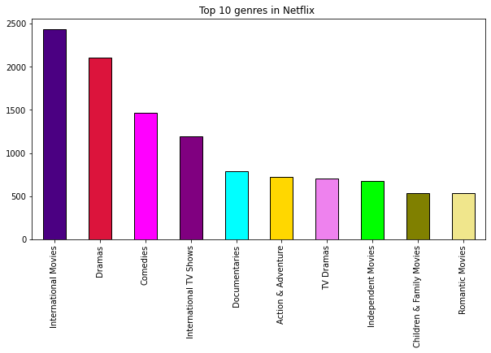
Analysis on Genres

Slide 13
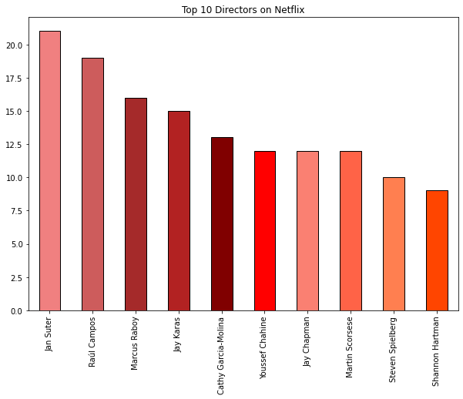
Analysis on Top Directors

Slide 14
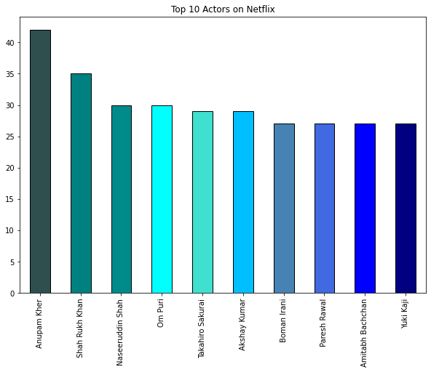
Analysis on Top Actors

Slide 15
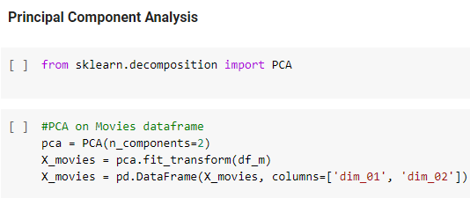
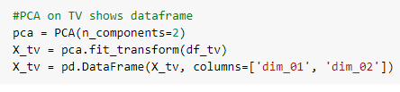
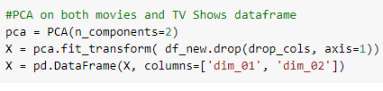
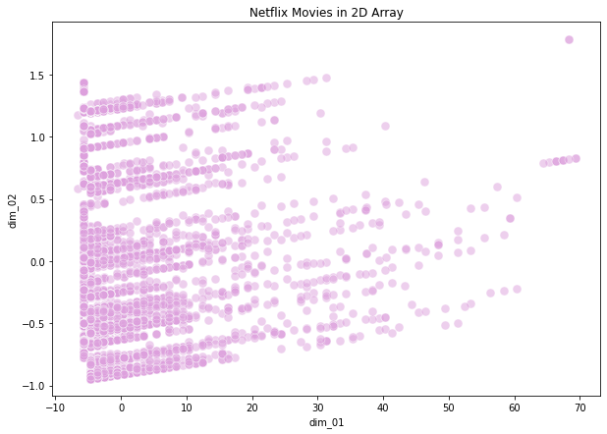
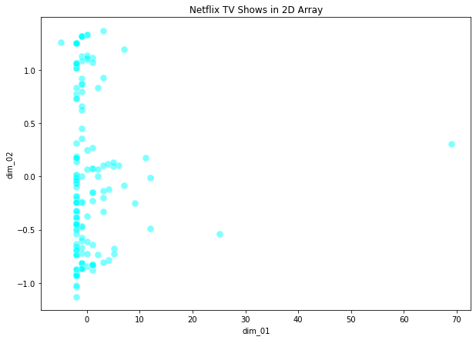
Data Pre-processing
Doing PCA on Movies and TV Shows Dataframe and Visualising them

Slide 16
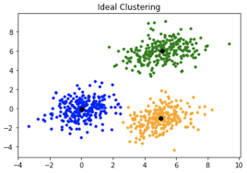
Clustering
K-means Clustering
K-means clustering is a method used for clustering analysis, especially in data mining and statistics. It aims to partition a set of observations into a number of clusters (k), resulting in the partitioning of the data into Voronoi cells.

Slide 17
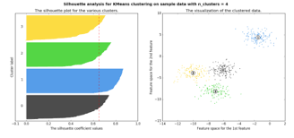
Silhouette Analysis
What is Silhouette score?
Silhouette Coefficient or silhouette score is a metric used to calculate the goodness of a clustering technique. Its value ranges from -1 to 1. 1: Means clusters are well apart from each other and clearly distinguished.
How is Silhouette Score calculated?
The Silhouette Coefficient is calculated using the mean intra-cluster distance ( a ) and the mean nearest-cluster distance ( b ) for each sample. The Silhouette Coefficient for a sample is (b - a) / max(a, b) . To clarify, b is the distance between a sample and the nearest cluster that the sample is not a part of.
What is a good Silhouette Score?
The value of the silhouette coefﬁcient is between [-1, 1]. A score of 1 denotes the best, meaning that the data point i is very compact within the cluster to which it belongs and far away from the other clusters. The worst value is -1. Values near 0 denote overlapping clusters

Slide 18
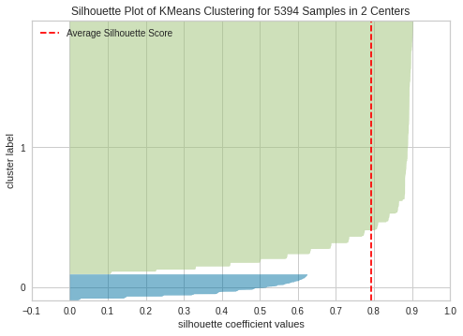
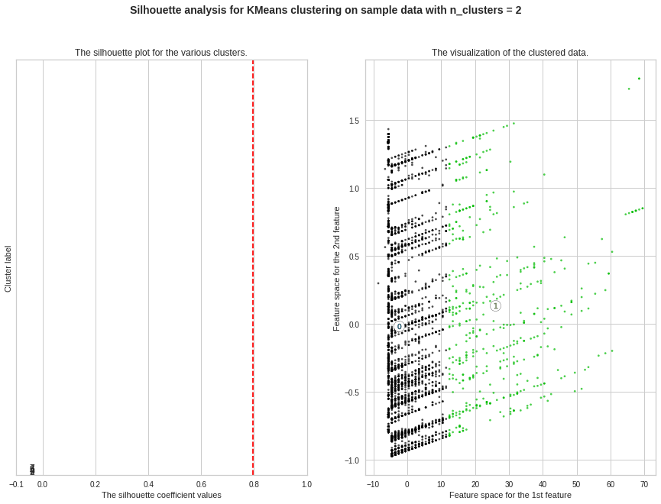
Silhouette Analysis
For n_clusters = 2 The average silhouette_score is : 0.7967445091683506

Slide 19
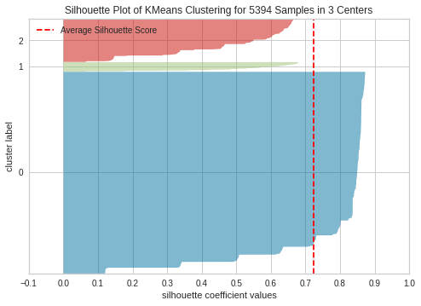
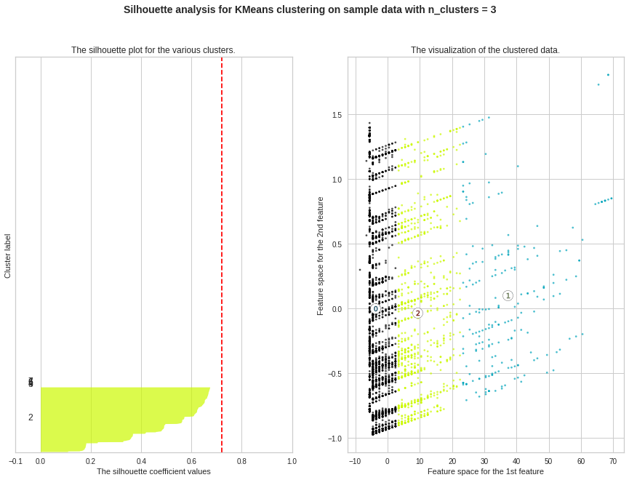
Silhouette Analysis(cont…)
For n_clusters = 3 The average silhouette_score is : 0.7211450864309327

Slide 20
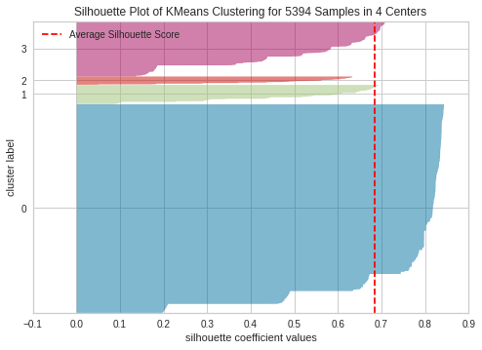
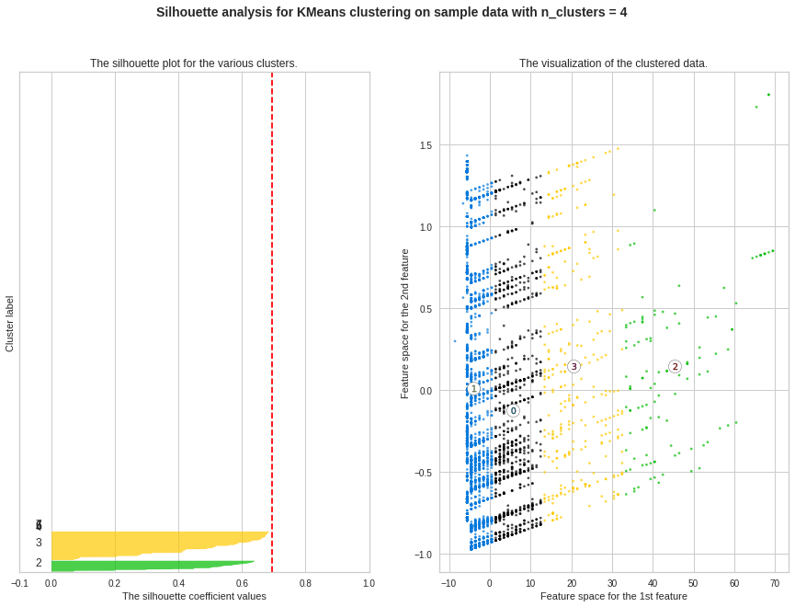
Silhouette Analysis(cont…)
For n_clusters = 4 The average silhouette_score is : 0.6941973569972131

Slide 21
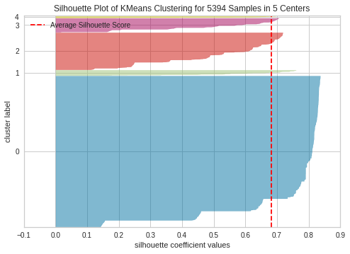
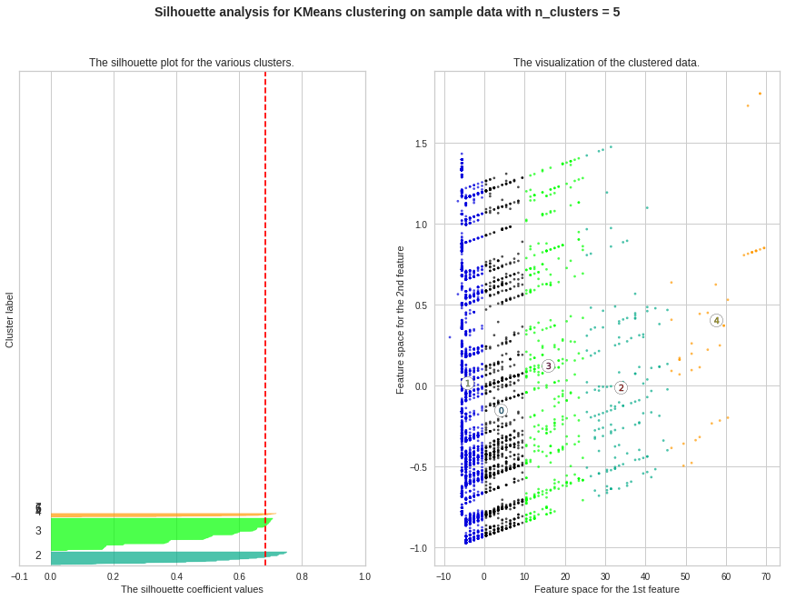
Silhouette Analysis(cont…)
For n_clusters = 5 The average silhouette_score is : 0.6820107017566107

Slide 22
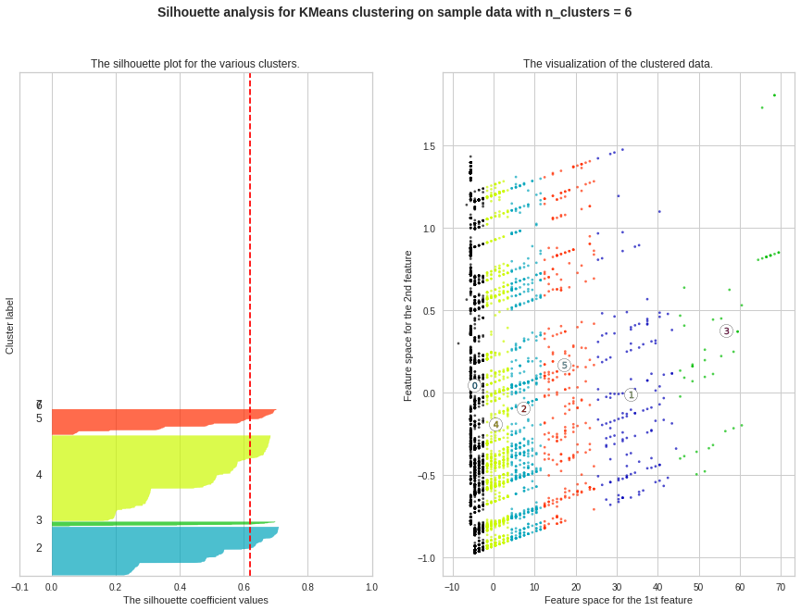
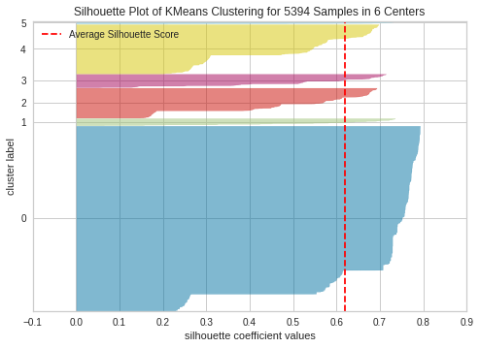
Silhouette Analysis(cont…)
For n_clusters = 6 The average silhouette_score is : 0.6190910305200903

Slide 23
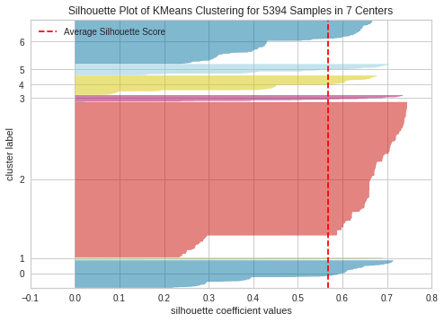
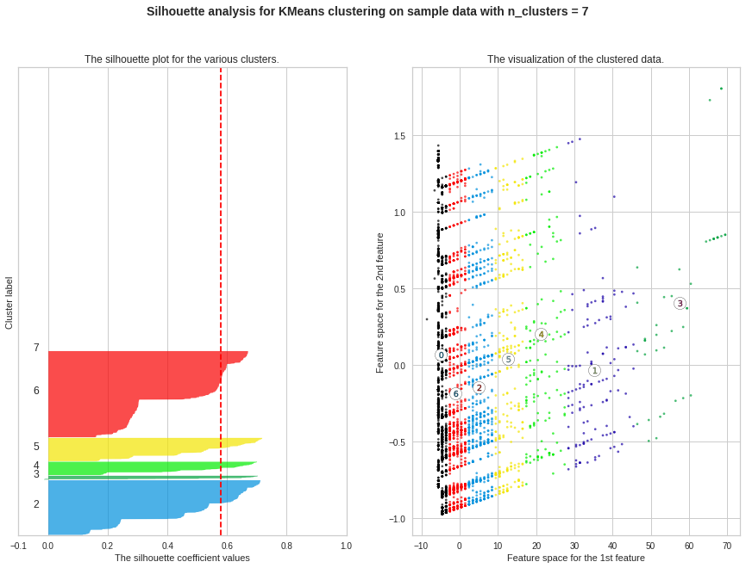
Silhouette Analysis(cont…)
For n_clusters = 7 The average silhouette_score is : 0.5796102431170737

Slide 24
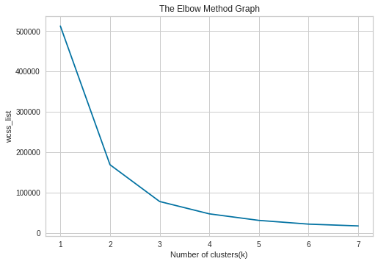
Elbow Method
The elbow method runs k-means clustering on the dataset for a range of values for k and then for each value of k computes an average score for all clusters. By default, the distortion score is computed, the sum of square distances from each point to its assigned center.
The elbow method is a heuristic used in determining the number of clusters in a data set. This method consists of plotting the explained variation as a function of the number of clusters and picking the elbow of the curve as the number of clusters to use.
This method is suggesting the optimum number of clusters as 3.

Slide 25
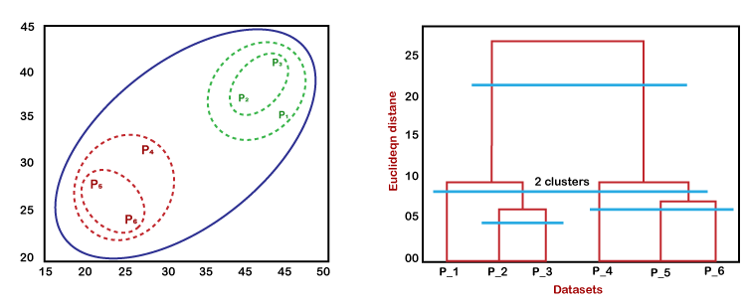
Hierarchial Clustering
The agglomerative hierarchical clustering algorithm is a popular example of HCA. To group the datasets into clusters, it follows the bottom-up approach. It means, this algorithm considers each dataset as a single cluster at the beginning, and then start combining the closest pair of clusters together. It does this until all the clusters are merged into a single cluster that contains all the datasets.
This hierarchy of clusters is represented in the form of the dendrogram.

Slide 26

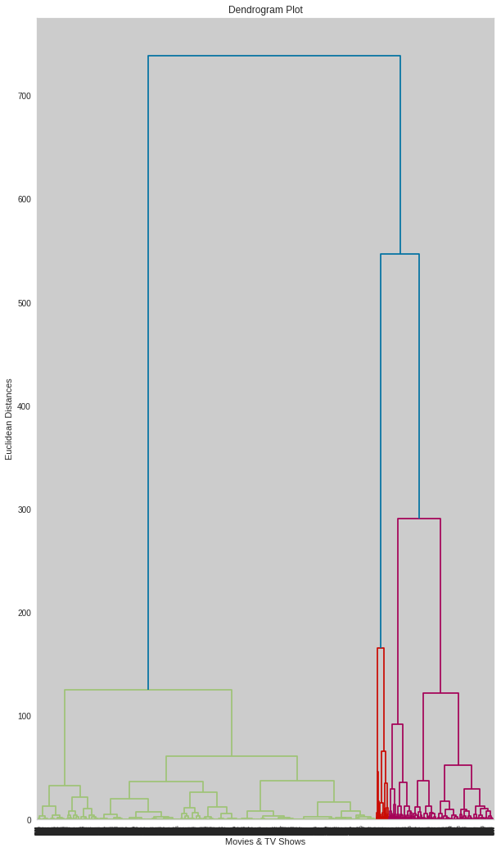
Hierarchial Clustering Visualisation
Again, we are getting the number of clusters as 3.
So, all the methods are suggesting 3 clusters for best results.

Slide 27
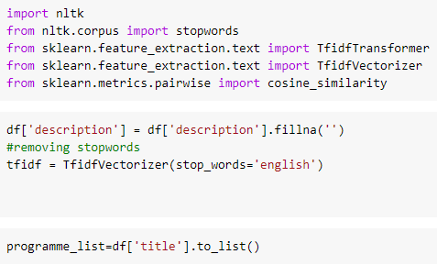
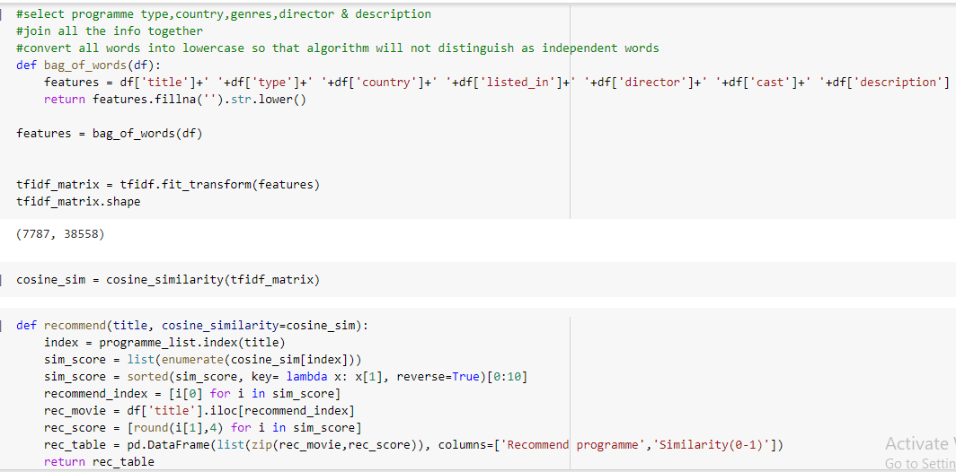
Recommendation System

Slide 28
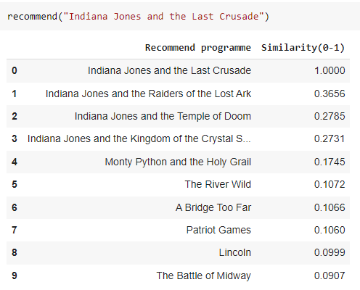
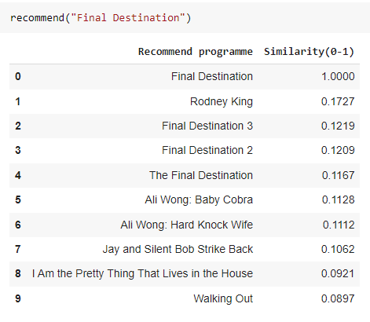
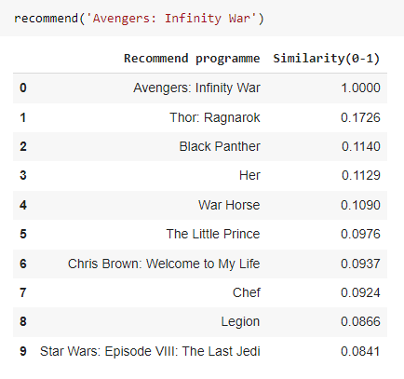
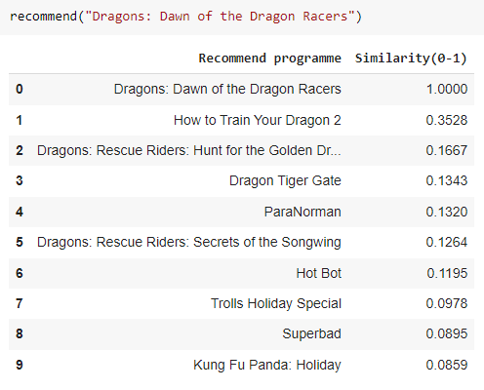
Recommendation System Evaluation
I think it is working good…….

Slide 29

Conclusion
It's evident that Netflix has grown over the years by many folds. We can see it from the data that the company took certain approaches in their marketing strategy to break into new markets around the world. Based on an article from Business Insider, Netflix had about 158 million subscribers worldwide with 60 million from the US alone and almost 98 million internationally. Netflix's original subscriber base used to be from the United States solely following its IPO. A large part of its success was due to the decision to expand to international markets especially countries like India which is a huge market and has a high purchasing power. We can see the dominance of Indian Actors and Directors as a major chunk of the top Actors and Directors are based in India. The popular markets prioritizes what content the company will release. In this case, we can see that a good amount of international movies and TV shows were added over the years as part of Netflix's global expansion.

